Slide 1
BRINGING TRITON TO AMD GPUs
Jason Furmanek, Lixun Zhang

Slide 2
AMD GPU Backend Status update
Support began about one year ago
Originally explored as dependency of DeepSpeed​
Pytorch 2.0 accelerated our involvement
Where is the code?​
Now enabled as a 3rd-party backend! https://github.com/openai/triton/pull/1983
Links to a commit in our repository
http://github.com/ROCmSoftwarePlatform/triton
AMD GPU backend development continues here; submodule commit will be periodically updated
Hardware Support​
Support CDNA GPUs (AMD Instinct MI100/MI200)​
Experimental support on RDNA GPUs​
Device detection at runtime
Full support for torch.compile in Pytorch 2.0
Pytorch 2.1 support in progress
When calling into triton.compile, use device_type="hip"​

Slide 3
Scoping the port
Why Triton (on AMD GPUs)?
Support Deepspeed and pytorch
Lots of customer interest
Triton design to block at the kernel level vs the thread level
Designed on NVIDIA but also a natural fit for AMD GPUs
All the good design of the Triton can also benefit AMD GPUs
LLVM and MLIR
AMD ROCm toolchain is upstream LLVM based
AMD has already invested heavily in LLVM and MLIR
Dialect needs
TritonGPU IR mostly re-used
no new ops added to TritonGPU Dialect
Lower dotOp to MFMA layout added
Shared memory access to avoid shared memory bank conflicts
same swizzling patterns
Conserve LDS space in favor of VGPR usage (example: Keep Q tensors in registers)
Port PTX usage with amdgcn assembly and MLIR
AMD INSTINCT MI200 (CDNA2)
MatrixCore (MFMA)
Multiple layouts/sizes supported
Up to 220 CUs
(4) 16 lane SIMDs per CU
512 VGPRs
Shared Memory
64k Local Data Store (LDS)
32 banks
128 GB HBM2e

Slide 4
Triton Enablement Approach
Support Empty Kernel
Support base set of Triton Ops
Memory, math, creation, linearAlgebra, reduction
Dot via vector FMA
Enable Matrix Core support
dot
FlashAttention
Maximize Occupancy and Efficiency
Increased wavefronts per CU
Pipelining
Swizzling
Wavefront size
Kernel launcher
Softmax
“We” are here

Slide 5
ROCM third party backend
The ROCm build now is a submodule
https://github.com/openai/triton/tree/main/third_party
-> amd_hip_backend @ d0ad70d
Currently links to a branch in github.com/ROCmSoftwarePlatform/triton
Built it! Checkout –recursive to grab all submodules
export TRITON_CODEGEN_AMD_HIP_BACKEND=1
git clone http://github.com/openai/triton --recursive
cd triton/python
pip install –e .
Changes for ROCm
Move dialect changes to TritonGPUROCM Dialect
Mlir::rocm::triton::gpu
/lib/Dialect/TritonGPUROCM
/lib/Conversion/TritonGPUROCMToLLVM is mostly a copy of TritonGPUToLLVM, but we're working to make it more precise

Slide 6
Optimizations on AMD Instinct GPUs

Slide 7
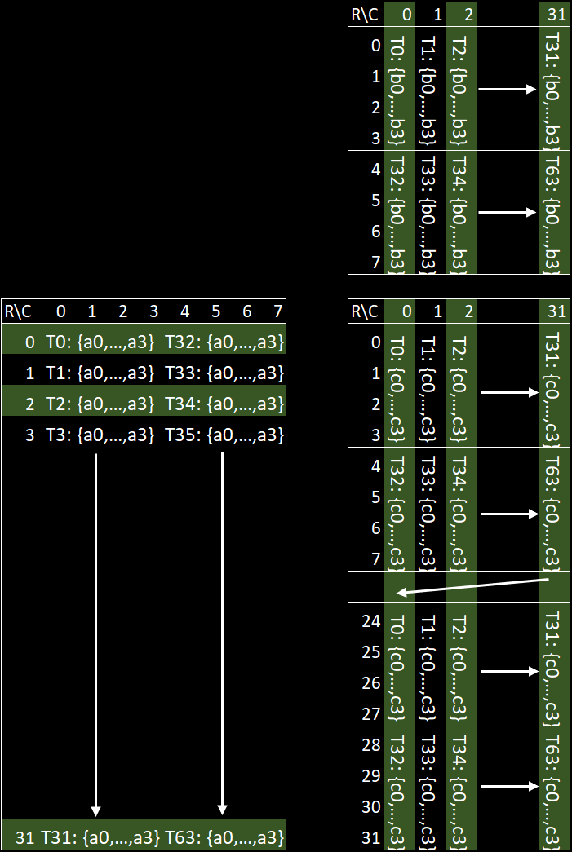
AMD Matrix Cores
Multiplicand B
Support full range of mixed precision operations for GEMM
Matrix fused multiply add (mfma) instructions
Format: mfma_CDfmt_MxNxKABfmt
Performance: see table below
Layout of mfma_f32_32x32x8f16
Layout: elements distribution among threads in a warp
warpSize = 64
Multiplicand B and Accumulator have the same layout
Multiplicand A and Accumulator’s layouts are “transposed”
Multiplicand A
Accumulators (C or D)
Data format | MI250X flops/Clock/CU
FP64 | 256
FP32 | 256
FP16 | 1024
BF16 | 1024
INT8 | 1024

Slide 8
Chained dot
Multiplicand B
The result of first dot is served as input to the second dot
Which input?
For input B, good to go
For input A, naïve implement requires LDS to transpose the output layout
For flash attention forward kernel, result of first dot is used as input A of the second dot.
Multiplicand A
Accumulators (C or D)

Slide 9

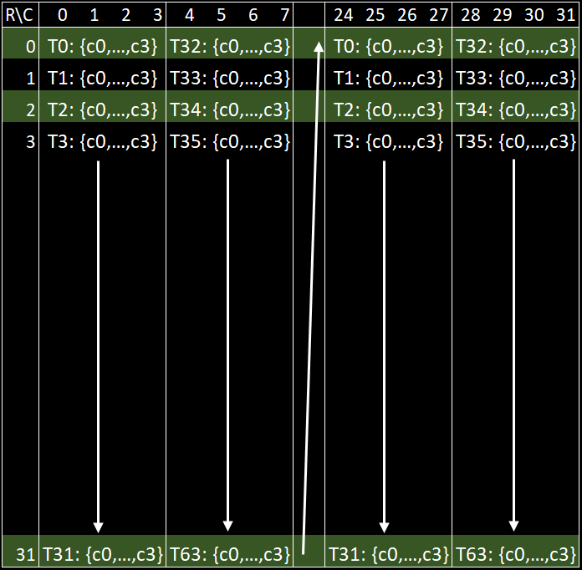




Chained dot --- optimization
mfma layout on $D^{T}$ = mfma.trans layout on $D$
Now it’s ready to be used as multiplicand A for the next dot
Transposition is achieved without transposing anything
SW: swaps operands
HW: interprets data “transposed”
Math: $D^{T}=B^{T}×A^{T}$
$$D^{T}$$
$$D$$

Slide 10
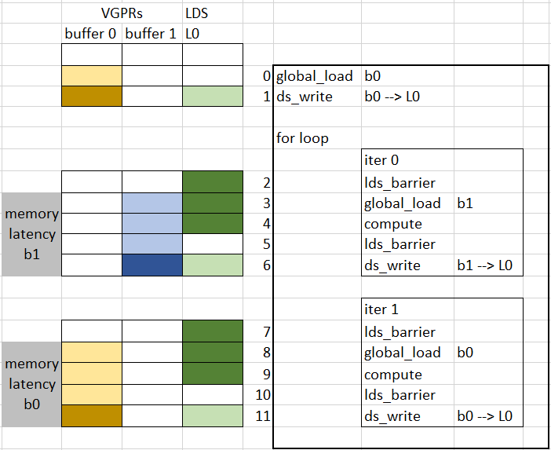
Software pipelining
2 stages → 1 VGPR
One buffer in LDS, more buffers in VGPRs
compute contains LDS_read and mfma
It always starts with data in LDS
One or more compute and global_load are overlapped
Save LDS, but increase register pressure

Slide 11
More optimizations
Keep Q in registers for small head_dim
Keep wavefronts vertically stacked, (i.e., warpsPerCTA={n, 1})
Reorder pointer arithmetic to maximize global load vector length
Tune waves-per-eu attribute
It can limit the number of registers used by each wavefront, spilling can happen
It can increase the number of wavefronts running concurrently

Slide 12
Current Performance on AMD Instinct GPUs

Slide 13
Performance with AMD Instinct MI250 --- GEMM
Dense GEMM for M=N=K=1024 ~ 8192
Larger gap with small GEMMs
We have more optimizations on the Todo list
Store mfmaEncodingAttr directly to global memory without going to LDS
Control wavefronts scheduling at finer granularity

Slide 14
Performance with AMD Instinct MI250 --- Flash attention fwd
Standalone flash attention forward kernel performance (triton tutorial)
Batchsize=4, nheads=48, head_dim=64
dropout=0, causal=False
NVIDIA DGXA100
CPU: 2xAMD EPYC 7742 64-core
GPU: Nvidia A100 80GB SXM
MI250 Supermicro 4124
CPU: AMD EPYC 7763 64-core
GPU: AMD Instinct MI250 OAM (128 GB HBM2e)
More optimizations
Software pipelining
We expect improvement of GEMM helps FA performance

Slide 15
Questions?

Slide 17
Backup slides

Slide 18
Introduction to AMD GPUs
Two AMD GPU Families
AMD Instinct (CNDA): Target Data Centers
AMD Radeon (RDNA): Target Workstations and Gaming
Some key differences relevant to Triton
CDNA 2 (MI250): 64 threads per Wavefront, MatrixCore (MFMA), FP16/BF16/INT8/INT4, OAM/PCIe, Infinity Fabric, 128G HBM2, 64k LDS
RDNA 3 (Navi): 32 threads per Wavefront, Wave MMA (WMMA), FP16/BF16/INT8/INT4, PCIe, 12G GDDR6
Architecture Capability Set defined in a "gfx" arch
CNDA 2: gfx9xx (i.e., gfx90a == MI200)
RDNA 3: gfx11xx
Software Stack
Triton Dialect (ttir, ttgir)
LLVM
Amdgcn (assembly), hsaco
ROCm Runtime
Terminology
Warp => wavefront (64)
ThreadBlock => workGroup (up to 16)
Thread => workitem
MMA => MFMA

Slide 19
Our progress on Flash attention fwd kernel
optimizations | speedup
Keep qk/p in register, a.k.a. the optimization for chained dot
Disable swizzling computation | 52%
Keep q in register | 13%
Enable swizzling for k-major matrices | 15%
Maximize global_load vector length via block_ptr semantics* | 26%
Set qk type to float32 | 9%
Set waves-per-eu=3 | 24%
* Note: we saw 150% perf improvement after maximizing global_load vector length for GEMM

